Slide 1
NextRoom
Nicolò Palmiero
Luigi Sigillo
Supervisor: Joy Abi Rizk
Repository
https://github.com/LuigiSigillo/IotBigProject

Slide 2
The Idea
Our idea is to build a web application that runs on your smartphone
During a tour in the Sapienza “Museo dell'Arte Classica”, it can suggest the next section you could visit based on the time you have spent in the previous sections
The application will display a preview of the suggested section, so that the user could choose to follow it or to jump to another suggestion.
A user can run the web application for all the duration of the museum tour
The smartphone starts collecting data, in an anonymous way, to make the best suggestions for every user
The suggestions are sent every time a user is leaving a section

Slide 3
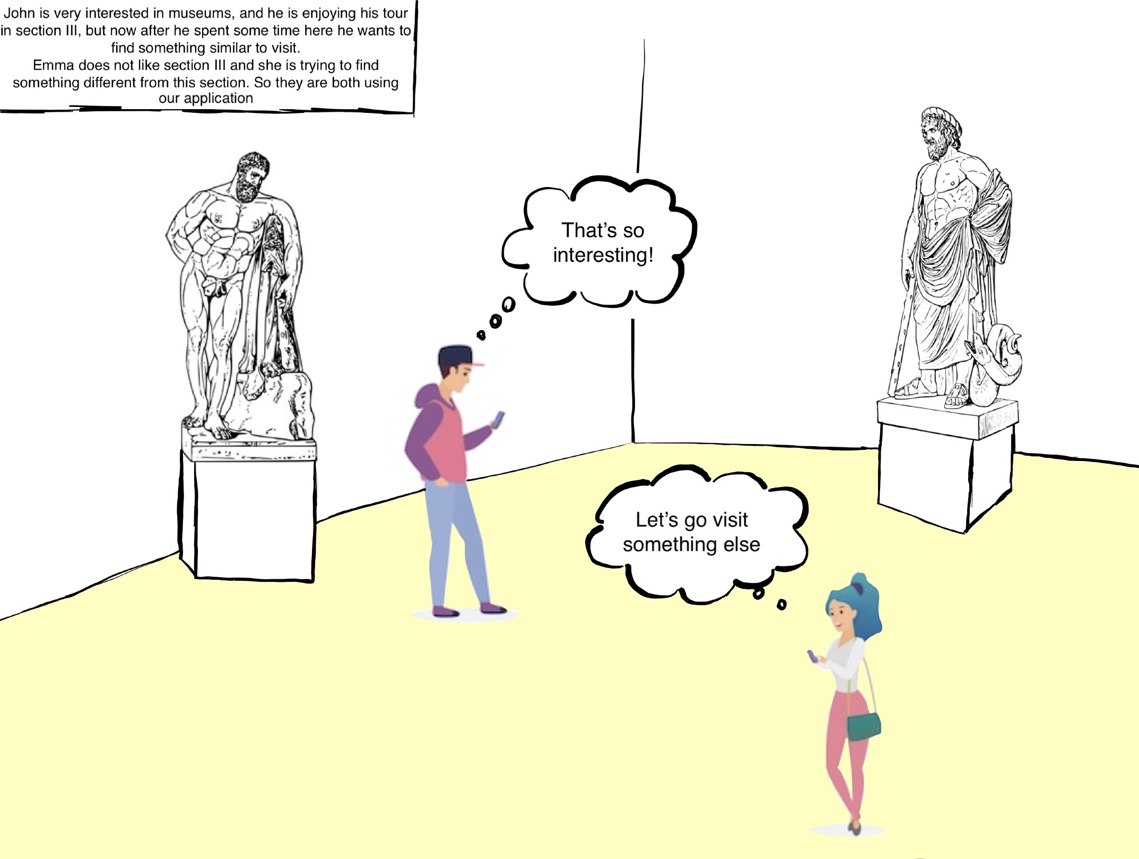
A Possible Scenario

Slide 4
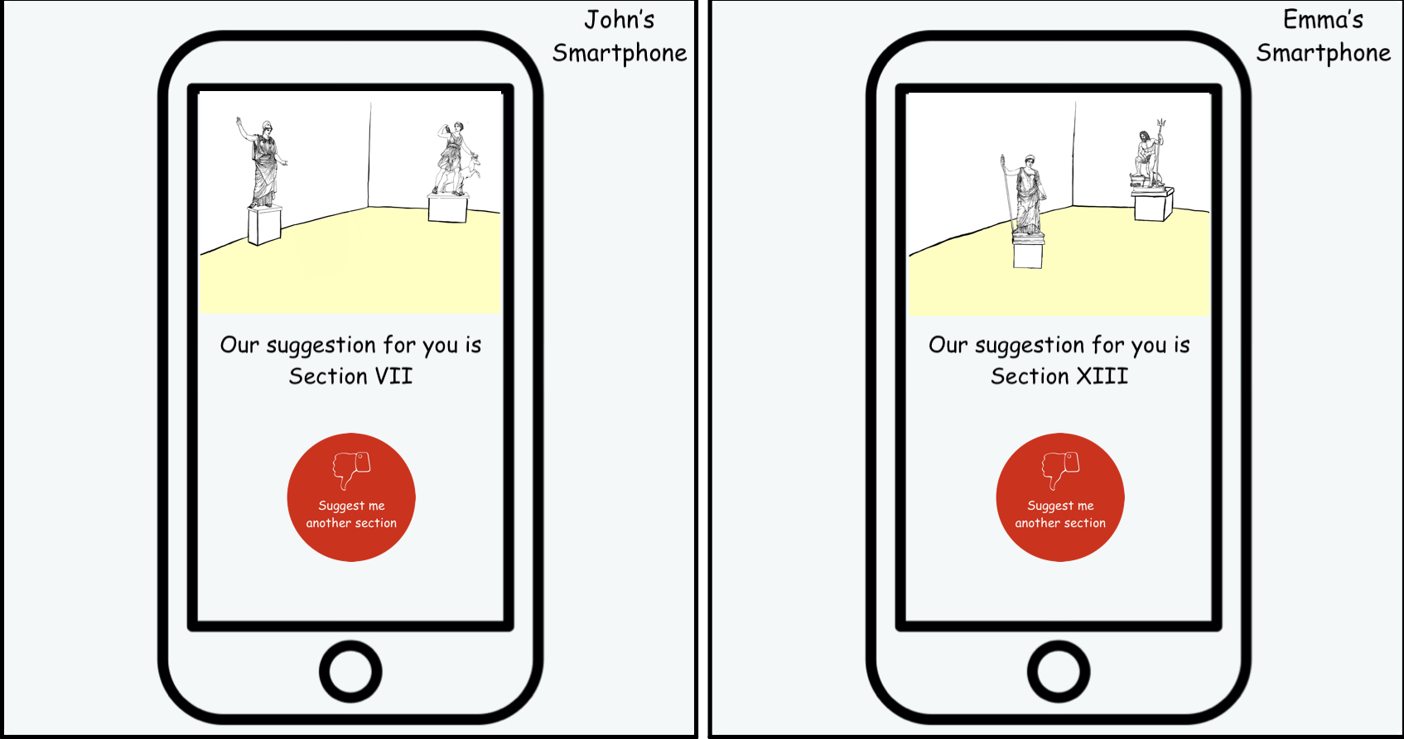
A Possible Scenario

Slide 5
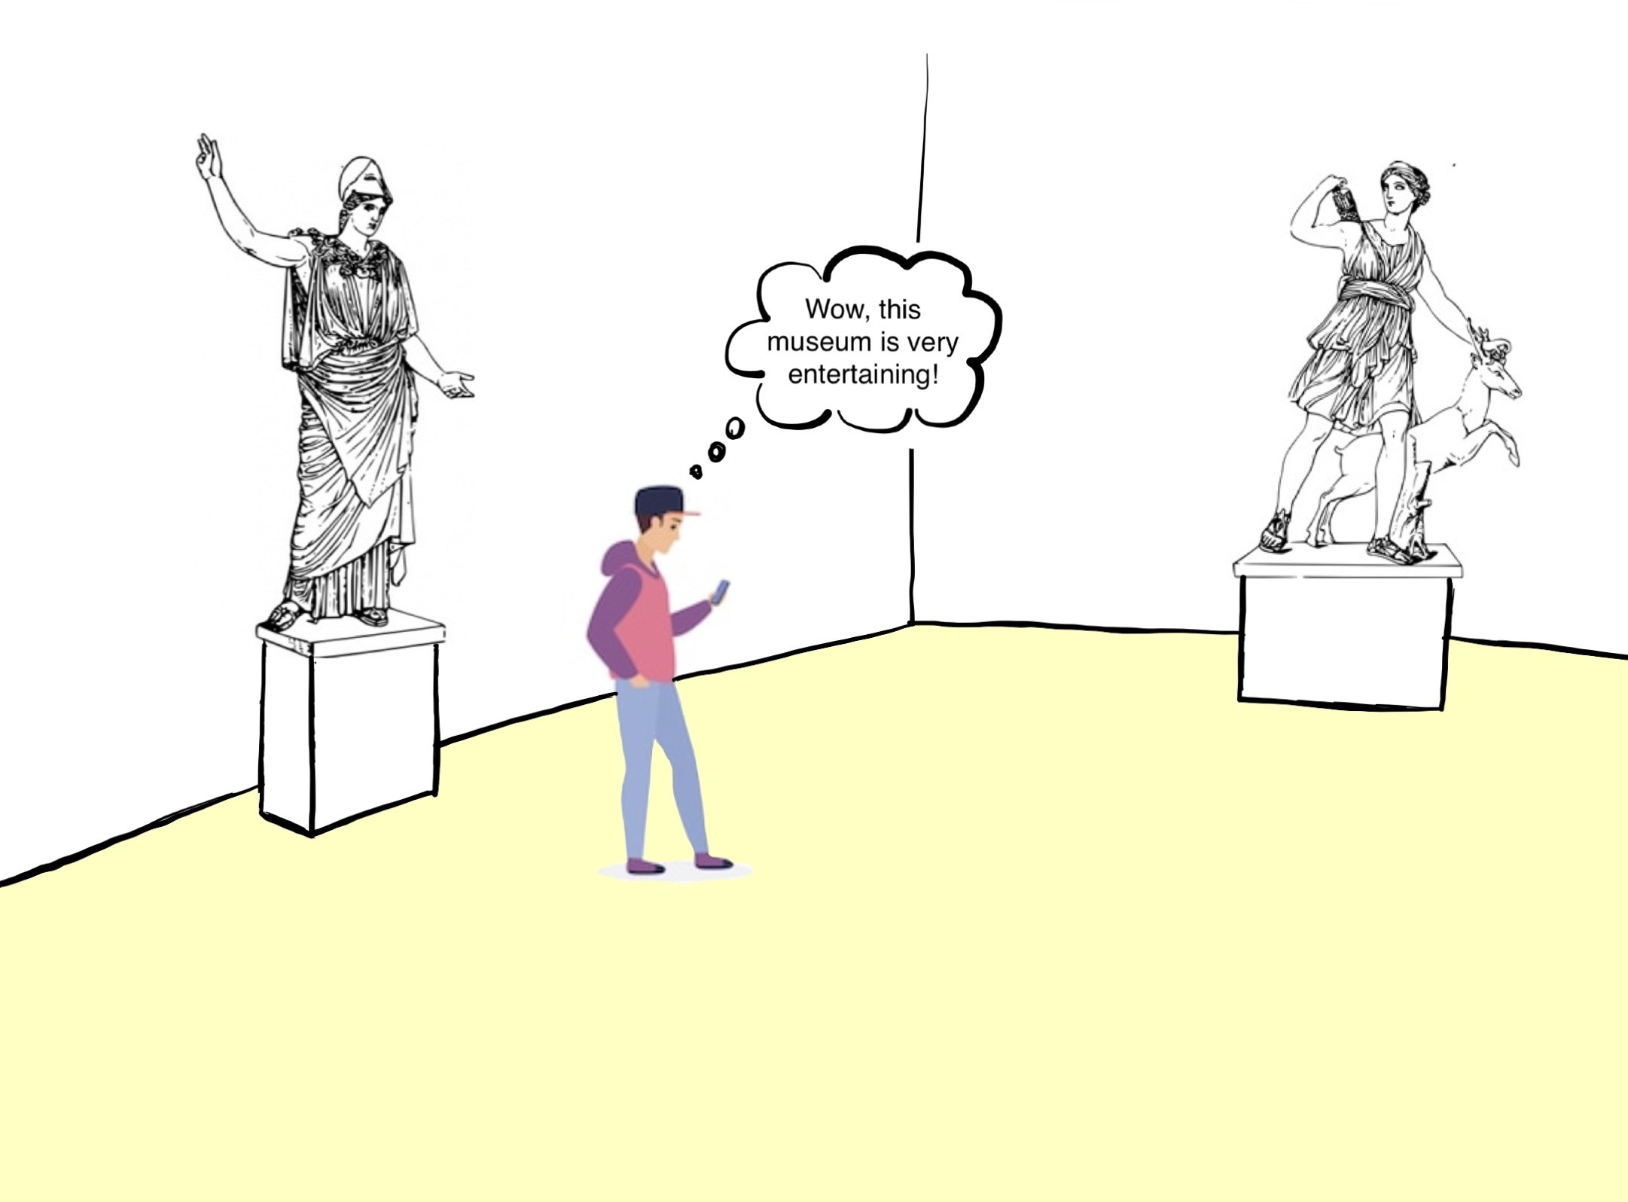
A Possible Scenario

Slide 6
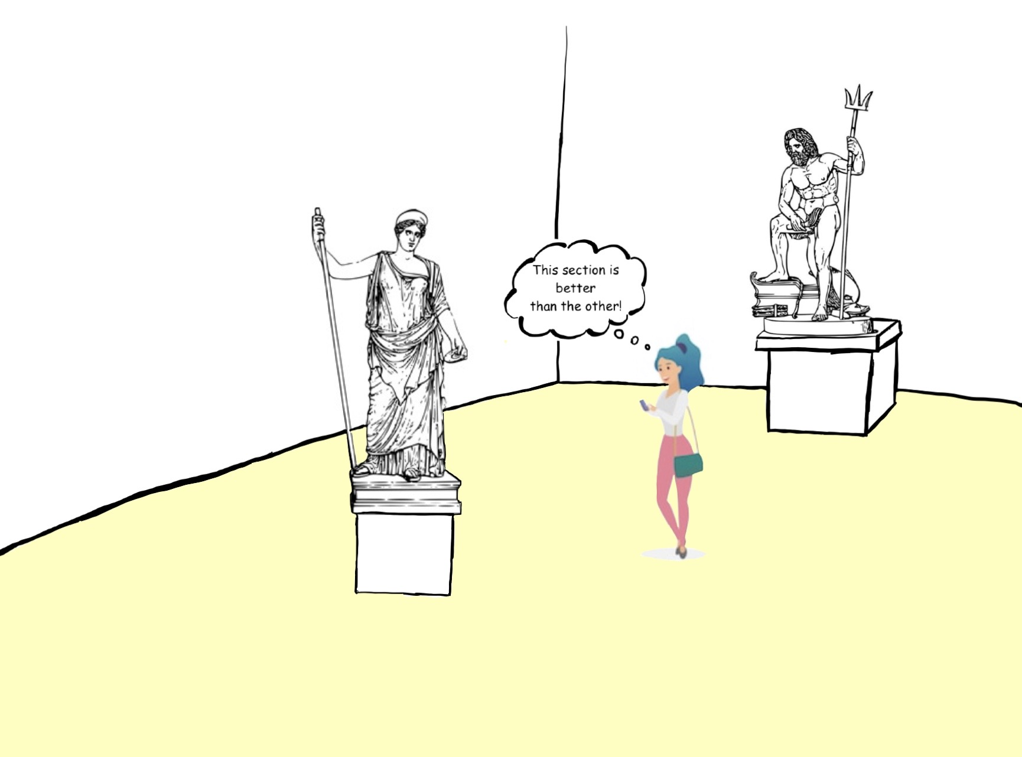
A Possible Scenario

Slide 7
User Experience Evaluation
We are planning evaluate the user experience using mockups, and after every demo of these prototypes we will collect people's opinions asking for feedbacks and publishing some google forms.
The questions will be mainly on:
User interface
Application services

Slide 8
Technical Evaluation
We will do a technical evaluation performing load tests on all parts of our system:
BLE IoT device-Smartphone interation: how many smartphones a single device can handle?
Cloud IoT device-Cloud interation: what is the message rate with which the device can send messages to Azure IoT hub?
Responsiveness Cloud-Smartphone interation: how fast the smatphone receives the advice on where to go, does it depend from the number of connected devices?

Slide 9


Technical Evaluation
LoRaWAN and TTN not used anymore.
40% of message loss with TTN.
MQTT with Eclipse Mosquitto broker

Slide 10
Pricing Evaluation
Board Pricing
The board used is the B-L475E-IOT01A Discovery kit that has a retail price of about 50€
Considering at least two rooms per section, the estimated cost will be around 500€
Cloud Pricing
Azure Function: the first 400,000 GB/s of execution and 1,000,000 executions are free. Then you pay what you consume (serverless)
App service: The basic plan cost around 60€, for testing purpose we will use the free one.
Azure SQL Database: We choose to use the serverless option also in the DB, we use the maximum size of 15GB but it is possible to use more space.

Slide 11
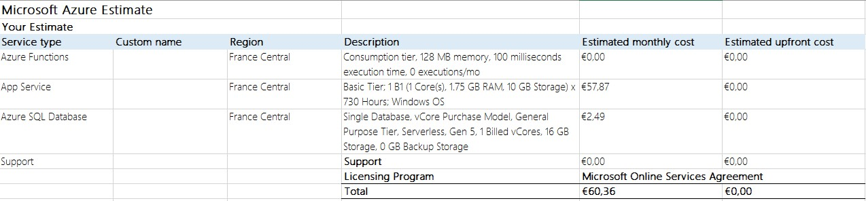
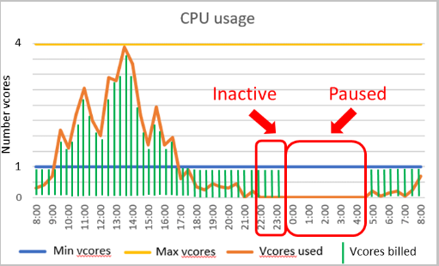
Pricing Evaluation

Slide 12
Architecture

Slide 13
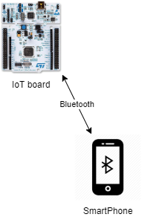
Typical scenario
BLE technology
Bluetooth beacon functionality

Slide 14
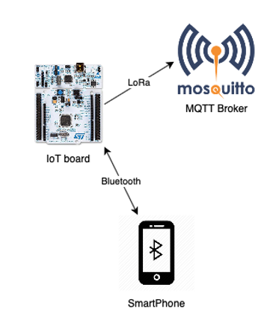
MQTT Protocol
MQTT protocol
Eclipse Mosquitto MQTT Broker

Slide 15
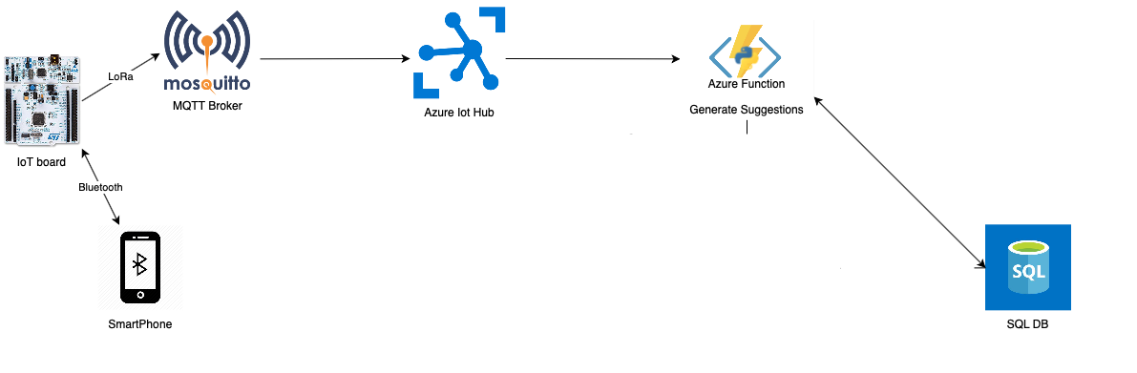
Cloud Services
Azure Cloud services
Azure Function
Azure IoT Hub
Azure SQL DB

Slide 16
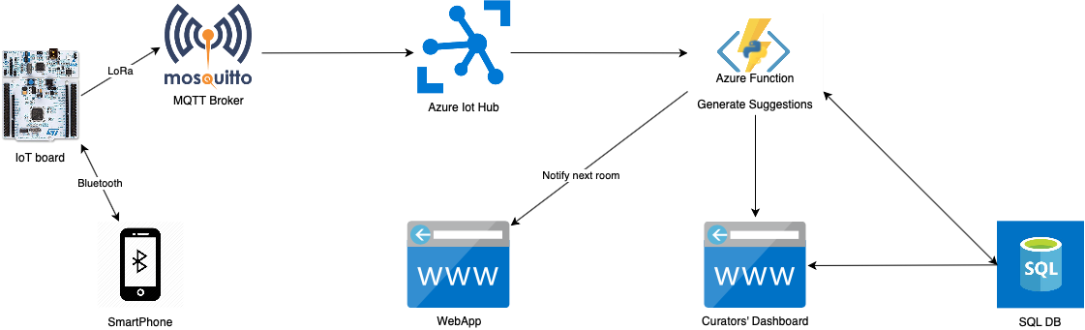
The complete flow
Azure App service will host the Web Application

Slide 17
Thank you for listening

